Slide 1
HOSPITALITY PROJECT
PRESENTED BY : SRUSHTI PALVE & ABHISHEK SHARMA
GROUP – 2

Slide 2
Project Summary
The aim of the project :
Revenue generation by the group of hotels across 4 major cities in India. The hotel was divided into 2 major categories like Luxury & Business.
Which category contributed what % of business
How much underutilized each hotel was against the total capacity during that period. This is to understand the loss proportion incurred by the property due to no bookings.
Not only the revenue generation but also the project focus on identifying what % cancellation happened (is to understand why customers are cancelling) & no show.
Understanding the customer satisfaction levels by analysis the rating parameters like accuracy, check-in, cleanliness and few others. It helps in identify the hotels the areas of improvement.
Understanding the pattern which platform is used for booking the hotels like online, direct and many others, so that they can promote the hotels accordingly in different platforms.
Contribution % of each property in the revenue.

Slide 3
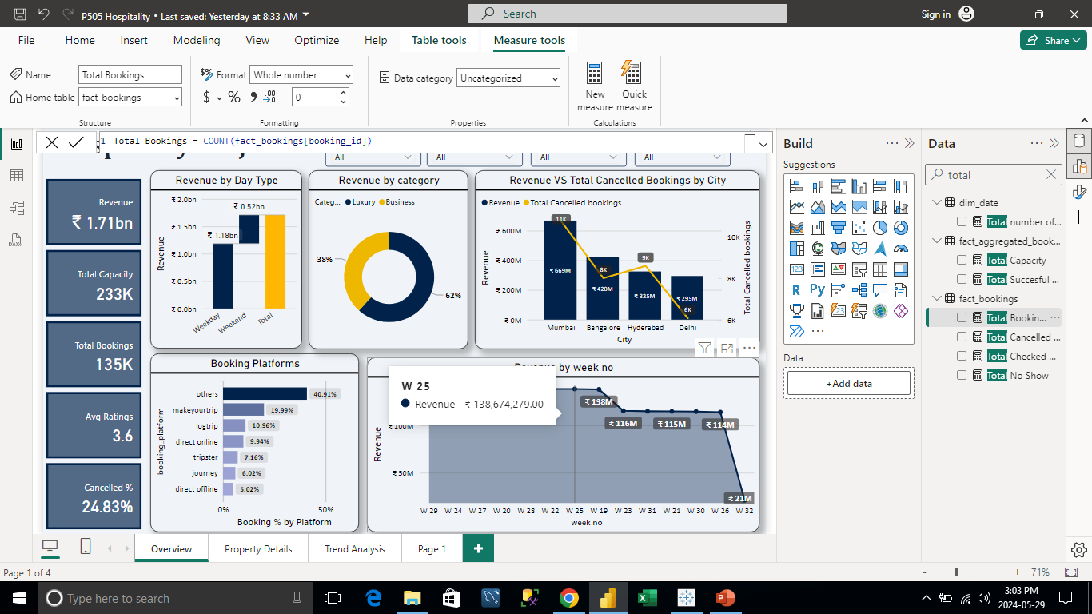
KPI
Some of the KPI’s
Revenue – It is overall revenue generated by all the properties from May to July.
Total Capacity – with use of Sum function and capacity column.
Total Bookings – with use of Count function and booking ID’s column.
Avg Rating – with use of Avg function and rating given column.
Cancelled % - with use of divide function and total cancelled booking & total booking.

Slide 4
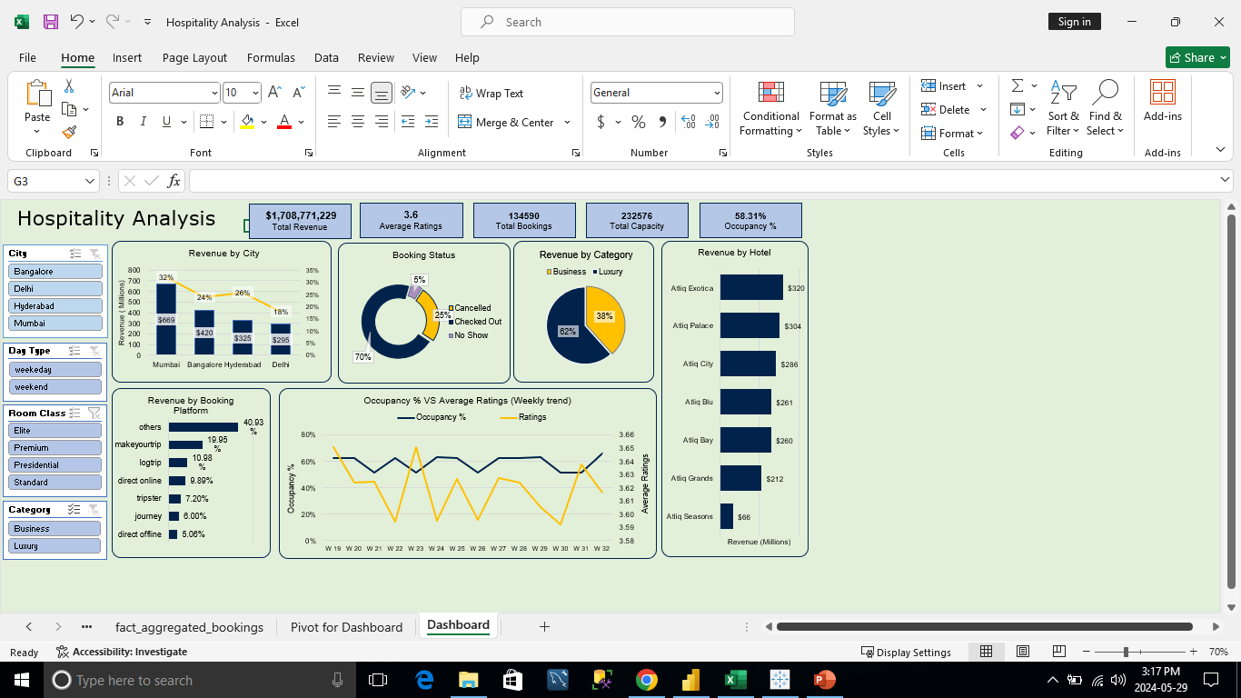


Dashboard - Excel
KPI
Filters

Slide 5
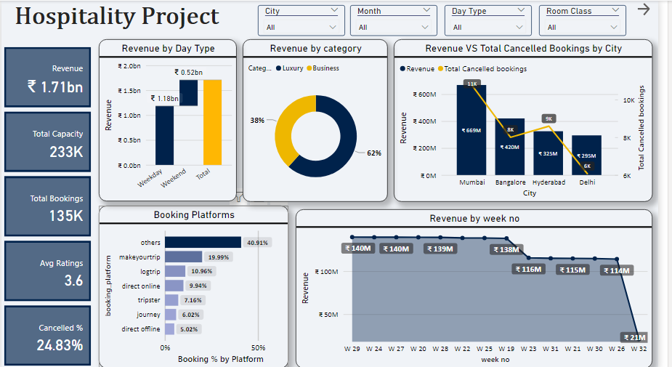


Dashboard – Power BI -1
Filters
KPI’s

Slide 6
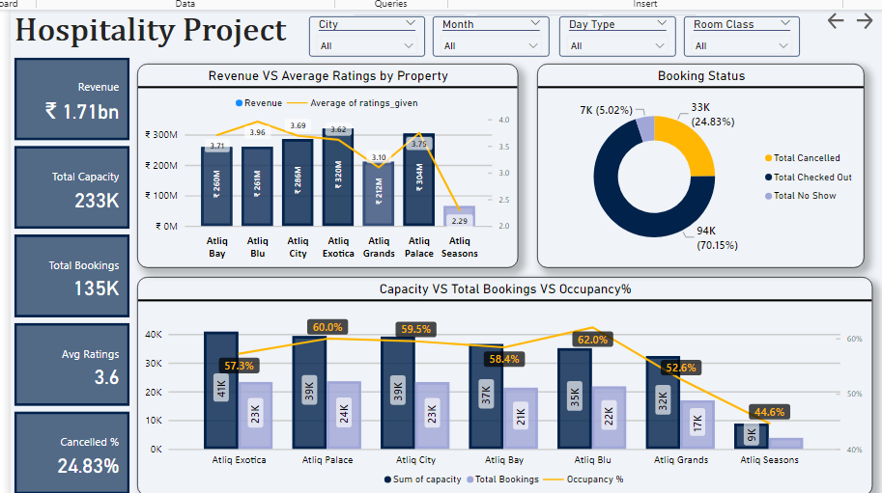

Dashboard – Power BI -2
Focused on Property Wise Details

Slide 7
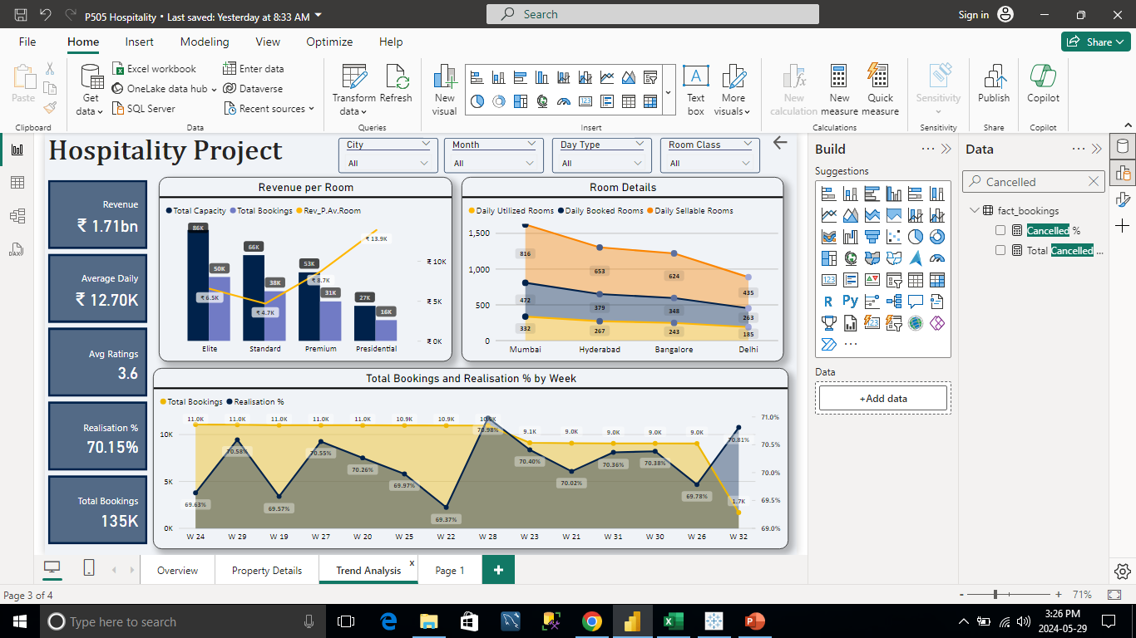

Dashboard – Power BI - 3
Focus on Room Wise Analysis & Weekly Trends

Slide 8
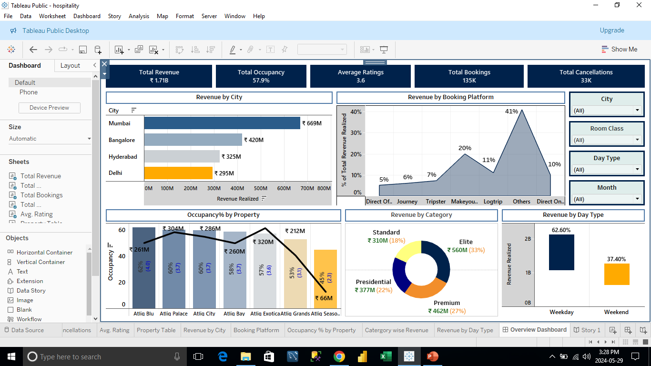
Dashboard – Tableau

Slide 9
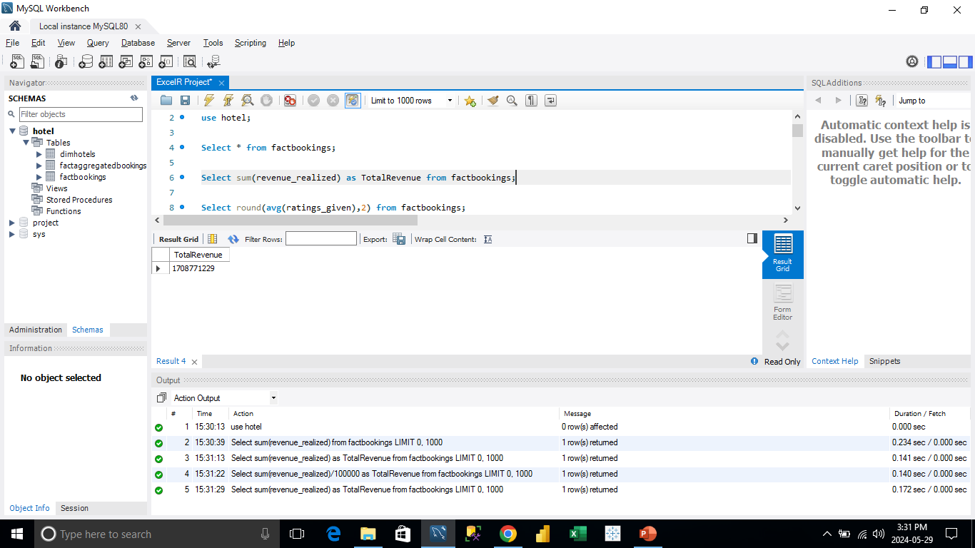
SQL
KPI – Revenue. With the function sum and select statement we could get the desired output. The table used to get the desired output is fact bookings.

Slide 10
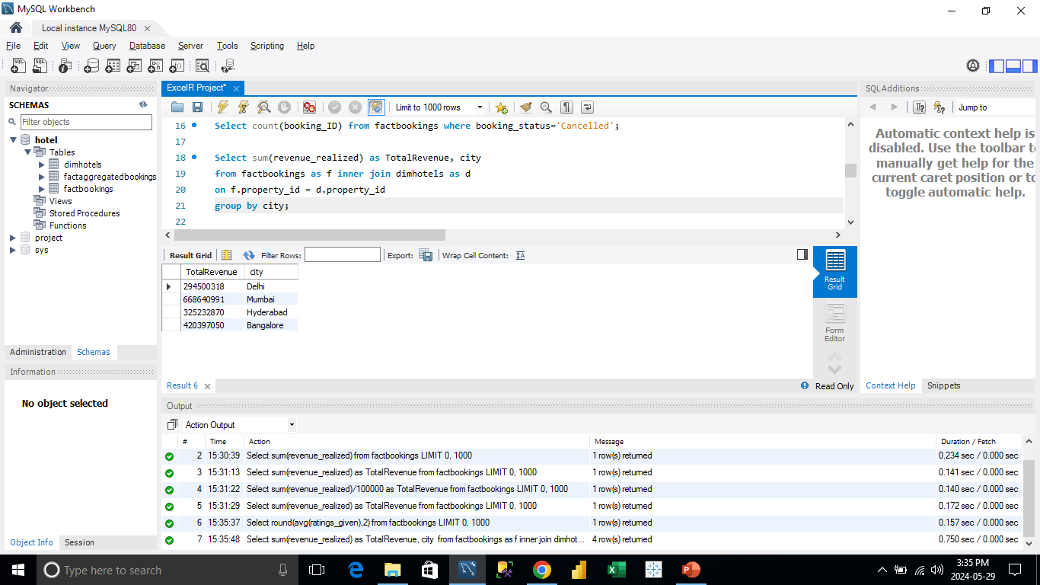
SQL
Joining of tables factbookings & dimhotels with inner join on column propertyID to get the output as city wise revenue. Also with the use of GROUP BY clause on city column.

Slide 11
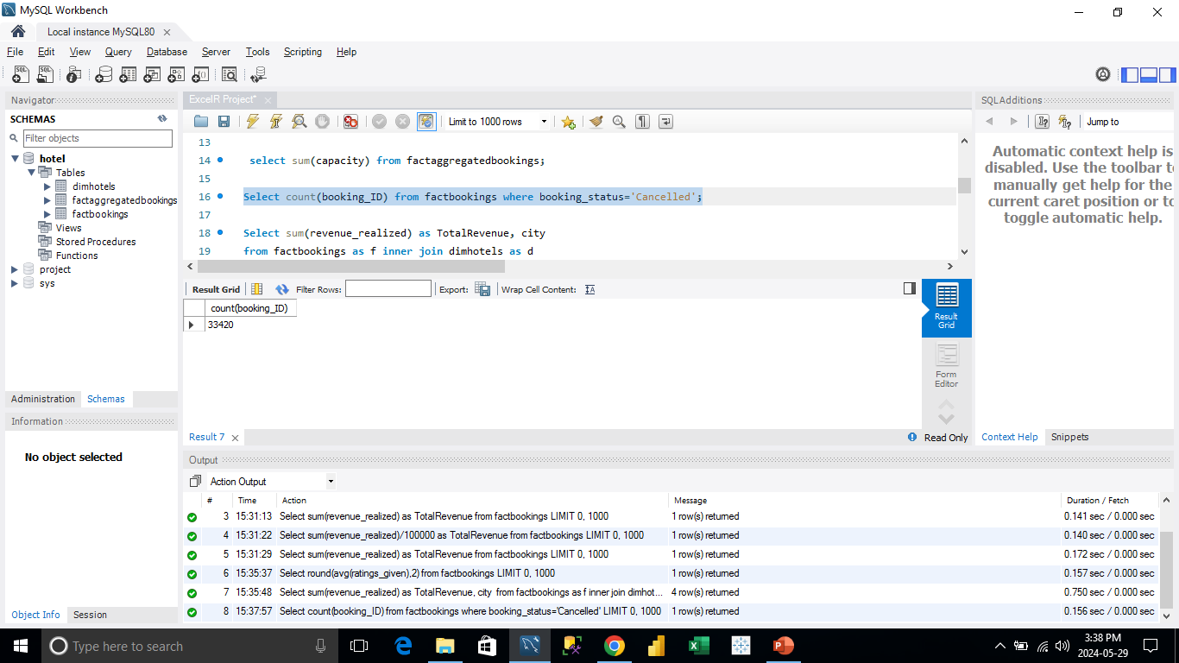
SQL
Output total Cancelled booking with use of WHERE clause. Where clause applied on the column booking status.

Slide 12
Key Insights
Total Revenue Generated is 1.71 BN within the span of 3 months.
Group of Luxury Hotels hold major share in the revenue generation. Ratio 62:38 (Luxury : Business)
Weekday business is double of weekend business. Hotels should focus on offers/In-Door entertainment activities to enhance the business during weekends too.
Increasing the advertising visibility on Others & Make My Trip platform, as it contributed approx. 60% of booking.
Occupancy rate is low where the customer rating is low . For instance, Atiq season contributed the lowest revenue, their avg rating is 2.9. So, hotels should focus on improving the ratings for high revenue generation.
Mumbai is the highest revenue generator whereas Delhi is the lowest contributor. Delhi Hotels need to work on the Avg Rating (esply. Atliq Bay & Atliq Cliq) and Avg pricing.

Slide 13
THANK YOU

